Slide 1
Advanced Microelectronics Lab ELCT 1001
amr.alaa@guc.edu.eg
C3.305 (Back office)
Sandy.abdelmalak@guc.edu.eg
C3.207

Slide 2
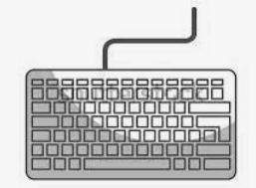

Project Milestone 1
Half duplex channel between two FPGAs
Expand racing game into multiplayer
FPGA 1
Communication
Protocol
FPGA 2

Slide 3
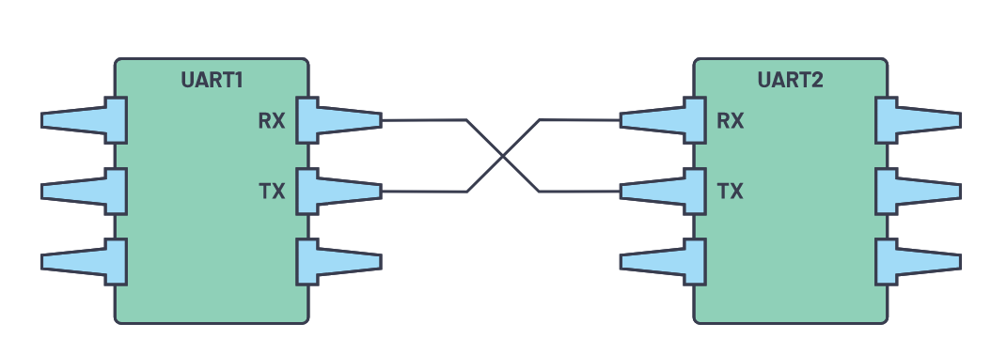
Communication Protocol
UART: Universal Asynchronous Receiver-Transmitter which is a serial communication interface between two devices.
In UART, the mode of transmission is in the form of a packet. The piece that connects the transmitter and receiver includes the creation of serial packets (bit by bit) and controls those physical hardware lines. A packet consists of a start bit, data frame, a parity bit, and stop bits.

Slide 4
Project Milestone 1
UART: Communication errors must be handled via checking the parity, start, and stop bits of the scan codes, as well as UART packets.
The receiver and transmitter must agree on the baud rate (signal changes per second) before initiating communication. For simple serial communication baud rate = bit rate, 9600 should be a good rate.
Write a finite state machine (FSM) to correctly read/write a UART packet (start, data, parity, stop).
Game: The racing game should now allow up to 4 player-controlled cars against procedurally generated cars.

Slide 5
Interface between FPGAs
Objectives:
Successful implementation of a communication protocol between multiple FPGAs [Basys 3 Boards] through a wired connection.
Transfer of data real time from one FPGA to the other using a half duplex protocol, with error handling.
Expanding the racing game into multiplayer.
Apply efficient hardware oriented design techniques.

Slide 6
Project Milestone 1
Interfacing multiple FPGAs and synchronizing communication.
Deliverables:
All the codes used with all the test benches, constraints and simulations
A report explaining into details all the work done + clear images for the output
A professional video showing a flow for the entire module with the output. Team members should appear and explain their contribution in the video in English.

Slide 7
Advanced Microelectronics Lab
Thank you for your attention, for any inquiries contact me through E-mail
E-mail: amr.alaa@guc.edu.eg

